Slide 1
Level 6 – Group 7 presentation
Ionut Ciobanu

Slide 2
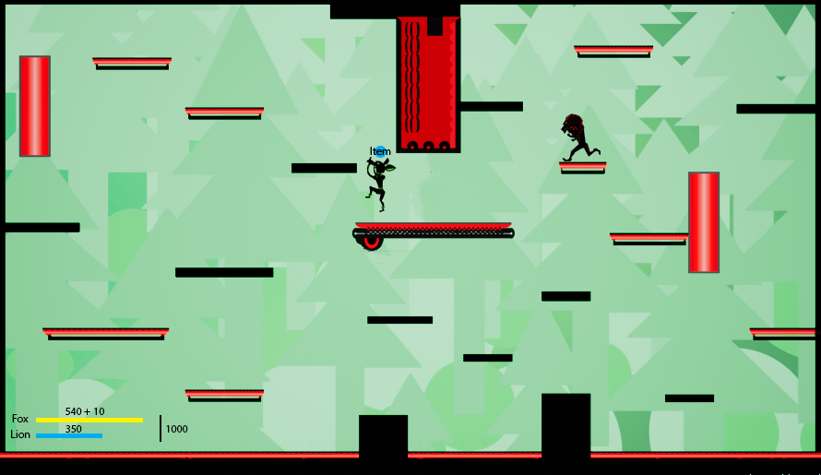
2D platformer
competitive
2 players
PC

Slide 3


Scoring

Slide 4
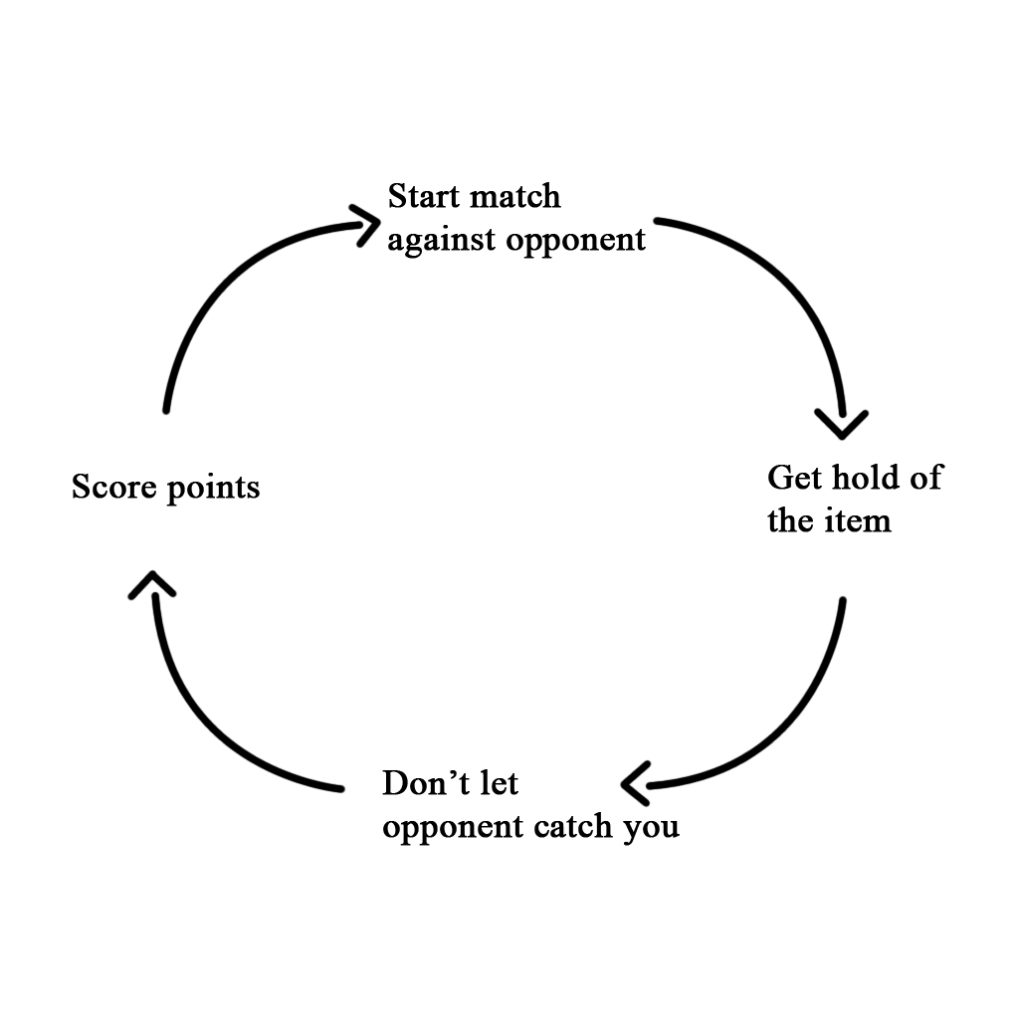
Core game loop

Slide 5
Layers of challenge
‘Learn – Practice – Master’ loop
Round 1
Round 2
Round 3
Round 4
+ mechanic
mechanic
+ mechanic
mechanic
mechanic
+ mechanic
mechanic
mechanic
mechanic
Difficulty

Slide 6
Learn – practice – Master
The match gets progressively harder each round
Players are given time to practice
By round 4 they will have practiced the 3 mechanics
Round 4 is the ‘boss’ round

Slide 7
Points distribution
Points
500
points
300
points
200
points
100
points

Slide 8
LEARN – PRACTICE – MASTER
Points
Difficulty

Slide 9
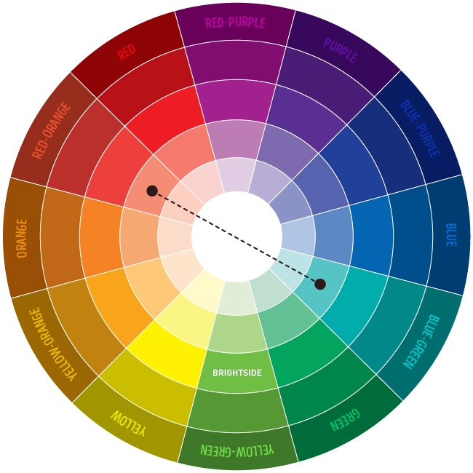
Art style
Simple
Vector based
Vivid
Contrasting

Slide 10
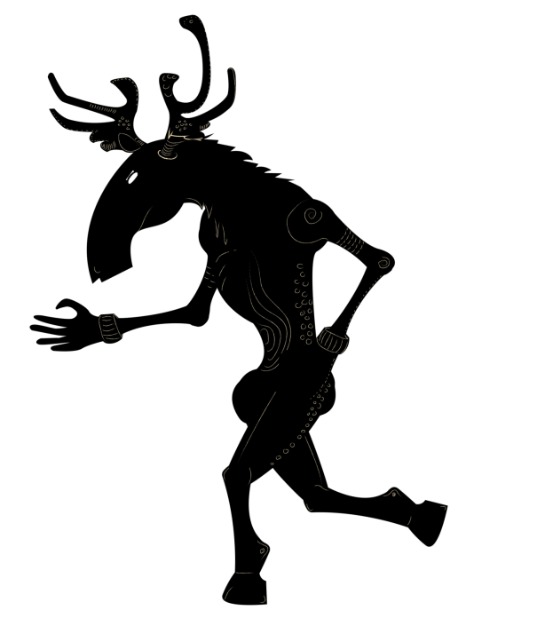



Art style

Slide 11
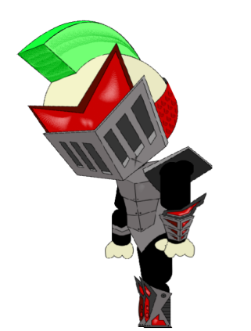





Art style

Slide 12
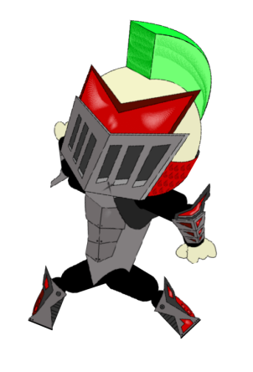

Target audience
Males
Ages 12 – 25
Casual and competitive gamers

Slide 13

Psychographic
Name: Jake
Gender: Male
Age: 19
Social status: Lives in a shared flat; hangs out occasionally and plays games regularly with friends
Activities: Full time student; also has a part time job
Personality: Would rather play games than watch shows; ambitious, competitive

Slide 14


Expectations
By early February I will have finished:
  Designing the characters, the platforms and backgrounds
  Coding – rounds, scoring system, mechanics
  Have a fully working version of the game

Slide 15
Thank you!
Any questions?

